Slide 1
HOME
Human Occupied Modular Environment
a sturdy and safe sustaining environment for people living between Emergency and Transitional shelter. easy to set up or move; Expandable; 360 degree ventilation and visibility without windows; provides water, power, storage, food, lighting, and human waste Containment; 120 sq ft; reusable; made in Rhode Island.
A presentation for the University of Rhode Island Colleges of Business Administration, Environment and Life Sciences, and Engineering. September 2010.
Notes:
I watched the NEWS on TV about the January 12, 2010, earthquake disaster in Haiti. I watched people go from living a normal life to being thrown out on the street with nowhere to go that was safe. Scavenged food and water. The docks at Port Prince were damaged. The single airport was useless. Relief agencies had difficulty getting in to help. People started robbing. Tent cities were set up, contributed by the Rotary International, through their sponsorship of ‘Shelter in a Box’. Probably the best example of a simple, easily transported, emergency shelter. I thought there’s got to be something sturdier, more livable, more complete, than the tents and shells. So I thought about designing a ‘human factored’ shelter using the knowledge and experience I’d gained working for Lockheed Martin for 33 years.
The acronym ‘HOME’ for Human Occupied Modular Environment seemed appropriate. After studying the types of emergency and transitional shelters offered by commercial companies, none really integrated simple things like electrical power and light and essential needs like water into the basic design. This new shelter had to be modular with no moving parts, fasteners, screws or instruction manuals. Sturdy enough to withstand the rains and winds in a place like Haiti. Yet not be a hot box like a shed but able to heat up and cool down gradually in a place like the Sudan. It had to be inexpensive to manufacture using recycled plastics, organic materials, and polymers. Easy to transport in ISO containers and on the ground by a pickup truck or by 2 people. It could be reused for something else after people move back to the disaster site. And, hopefully, most of the end products are made in Rhode Island. I’m imagining a manufacturing and assembly operation of about 50 people.

Slide 2
Agenda
My Background
The Issues
Types of Shelter
Photos of emergency and transitional shelters
Some detail characteristics of shelters
What if…
Taking a Systems Engineering Approach
System, Subsystem, and Elements
Notional Design
Notional Design Details
Systems Engineering Risks
Systems Engineering Tradeoffs
Next Steps – Plans A and B
Conclusion
Target Production Costs
Preferred Suppliers
Development Team Staffing and Skills
Team Concept of Operations
Notes:
Here is the agenda for this discussion. It should take at least an hour. Maybe 90 minutes with questions. We’ll look at my background and qualifications for this project. Some of the overall issues about worldwide disasters and providing shelter. Who uses shelter? We’ll see photos of different types of emergency and transitional shelters used in Africa and Asia. In tropical and desert environments. In flat and hilly terrain. And then what are some of the building characteristics of these shelters. How do they get setup? What’s needed to put them together in terms of tools, labor, equipment? What do the interiors and exteriors look like? What can you learn from these types of shelters in terms of cost burdens? And if we take a ‘systems engineering’ approach to developing a shelter, what do you have to think about? Cost? Manufacturing? Supportability? Materials? Human needs? And then we get to a ‘notional’ design. My design for a simple shelter that used a human-factored ‘systems engineering’ thought process and approach to design. And in keeping with systems engineering, what else is needed in terms of analyses and evaluations.

Slide 3
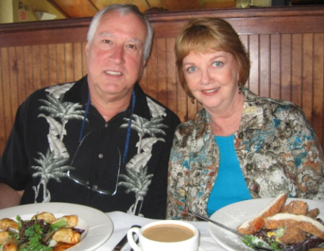
My Background
BA (Psychology, Biology), URI, 1971.
MA (Engineering Psychology), NMSU, 1974.
Senior Staff Human Factors and Systems Engineer, Lockheed Martin, Sunnyvale, CA, 1974-2007.
  Applied human factors engineering principles and design standards to mobile shelters, large facilities, missiles, ships, planes, spacecraft, command centers, equipment racks and consoles, transportation systems, handling fixtures, railcars, support equipment, computer human interfaces.
  Worked with mechanical and electrical engineering, systems engineering, manufacturing, training, logistics, parts, materials and processes, facility and field engineering and DOD customers and suppliers.
  Taught Specialty Engineering, CONOPS, Human Factors Engineering.
  Certified Human Factors Engineer #529.
Retired 2007 after 33 years in aerospace industry.
Married Julie Yingling (URI 1970) September 2008.
Moved to West Kingston, November 2008.
Rick and Julie at Turtle Soup.
Notes:
I started out in the college of engineering but couldn’t quite understand all those forces and vectors in statics and dynamics. I passed slide rule and math but I flunked statics and decided engineering wasn’t my calling. I was graduated in 1971 with majors in psychology and biology, and minors in stat and speech and hearing. Al Lott recommended I get a graduate degree at NMSU because it was far away from home, had a low student/faculty ratio, and the profs were from great universities. So I tried ‘engineering psychology’ which focuses on understanding the capabilities and limitations of humans and applying that knowledge to the design of equipment, user interfaces, and facilities so they are easy to use. In 1974, I got a job at Lockheed in Sunnyvale, CA and stayed there until 2007. I worked on ships and planes and communication centers, missiles, spacecraft, and submarines. Never a dull moment except between jobs when you’re looking for new work which was pretty often…. I retired in 2007, got married in 2008, and looked for a place to retire. Which turned out to be Rhode Island which is pretty amazing because most people leave RI for Florida and really don’t retire here. But it’s worked out very well.

Slide 4
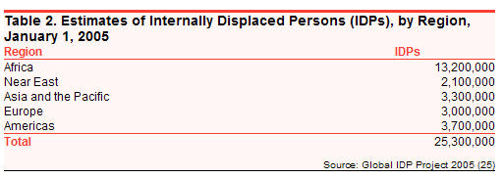
The Issues
Estimated 25 M Internally Displaced People (IDP) in 52 countries in 2005.
  Most IDP remain inside their own borders.
  70% are women and children.
  Estimated 36 M displaced by natural disasters (CY 2008).
All displaced people need immediate shelter from:
  Rain, heat, cold, insects, rodents, sun, wind, snow, dust.
International governments, NGOs, charities, foundations, non-profit organizations contributed $4.9B 2010.
  Red Cross, OXFAM GB, UN Development Program, UN Habitat, UN Refugee Agency, CERF.
United States committed/contributed $3.2B 2009.
Source: ReliefWeb (http://www.reliefweb.int/rw/dbc.nsf/doc100?OpenForm)
Notes:
Millions of internally displaced people (IDPs) and refugees are forced from their homes by natural disasters (floods, earthquakes, drought) or manmade disasters (environmental spills, war). And it seems to be getting worse with more people occupying less land. Most IDPs are in Africa with even distributions in other continents. Governments and NGOs spend billions on relief which includes medicines, food, clothing and shelter. So the need for shelter is not going away anytime soon. It’s only going to get worse.

Slide 5
Types of Shelter
Emergency
  Tarps, tents, plastic sheets, corrugated roofing.
  Life span of months to a few years.
  Example: Shelter-In-A-Box
Transitional
  Partial rigid wall structure using wood, concrete, steel, block, or brick.
  Most likely rectangular, vertical walls, framed, windows, doors.
  Example: World Shelter.
Permanent
  Rigid wall, solid floor and roof; better than pre-disaster.
  Example: Habitat for Humanity
Eventually, most people rebuild where they lived using local materials and labor consistent with culture.
Notes:
Now there are basically 3 types of shelter: emergency, transitional, and ‘original plus’. Many companies make emergency and transitional shelters for sale to the Red Cross, the United Nations, government agencies, private agencies, and charities. The most well known emergency shelter is the Rotary Clubs’ ‘Shelter in a Box’ started in CY 2000. A fantastic idea that quickly gets a tent and tools to people desperately needing immediate shelter. It’s all carried in a tote box and delivered on foot. In China, Haiti, and other disaster sites long before the indigenous government can muster aid. Emergency shelters are suppose to be short life span but sometimes end up being used for years. Tarps are replaced with plastic sheets and more tarps. Whatever is available. Some emergency shelters appear to be cross marketed to the military as well as consumer or relief agency. Thus, the set of features is very narrow since the requirements or target user base is very diverse.

Slide 6
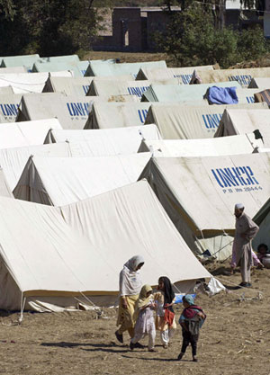
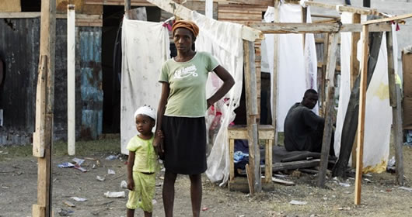
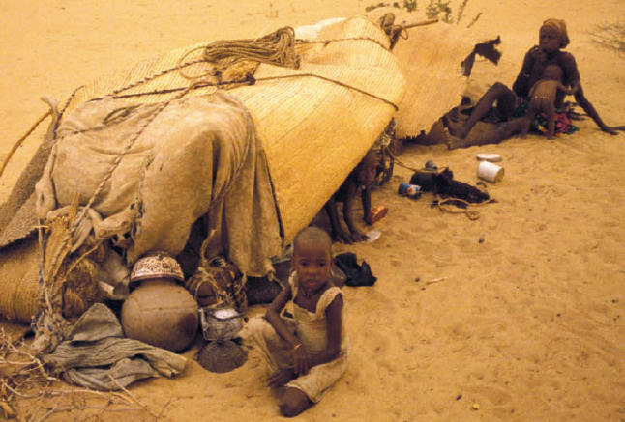
Examples of Emergency Shelter

Slide 7
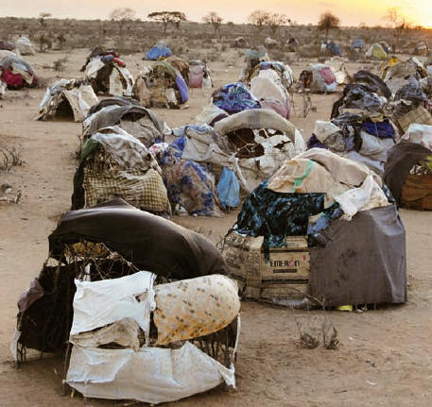
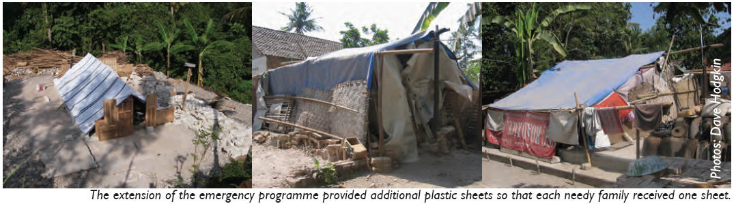
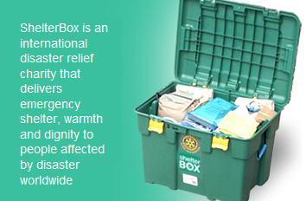
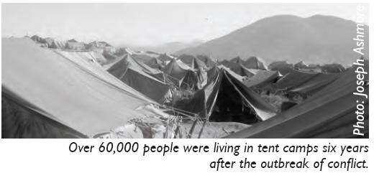
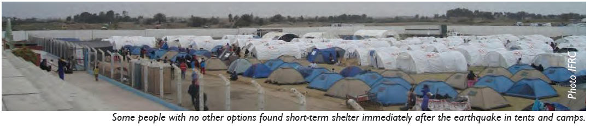
Examples of Emergency Shelter
Tom Henderson’s Rotary Club Shelterbox

Slide 8
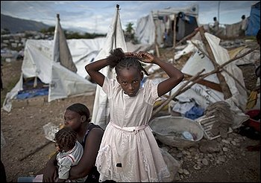
Examples of Emergency Shelter
Storm shreds aging tents in Haiti earthquake camps.
By JONATHAN M. KATZ
The Associated Press , Saturday, September 25, 2010; 11:43
PORT-AU-PRINCE, Haiti -- The sudden, powerful storm that ripped through Haiti's battered capital destroyed thousands of tents in the homeless camps where more than 1.3 million people live eight months after the earthquake destroyed their homes, shelter officials said Saturday.
The death toll from Friday afternoon's storm stood at six people, with nearly 8,000 tents damaged or destroyed, according to a statement from the United Nation's International Organization for Migration. The organization said it had distributed 5,000 tarps.
The storm's effect was exacerbated by the flimsiness of tarps and tents that have been baking, soaking and flapping in the Caribbean elements since the Jan. 12 earthquake killed at least 230,000 people and left millions homeless. Hundreds of thousands of families continue living on the streets of the capital waiting for temporary housing or money to find new apartments.
"Many of the tents that were destroyed had reached their end of lifespan," said Gerhard Tauscher, shelter cluster coordinator for the International Federation of the Red Cross.
AP / Ramon Espinosa
Tents designed to last 8 m0nths.

Slide 9
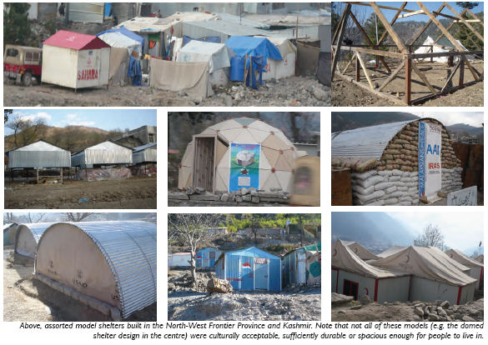
Examples of Transitional Shelter

Slide 10
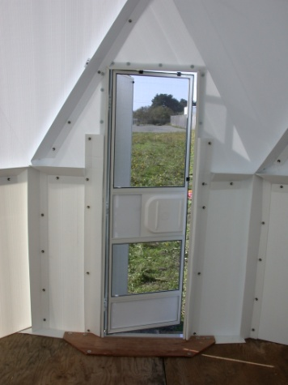
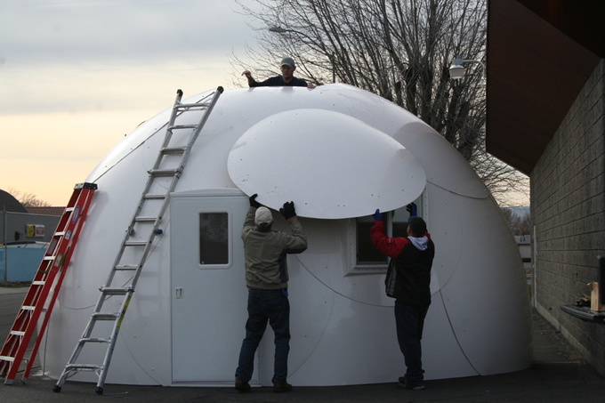
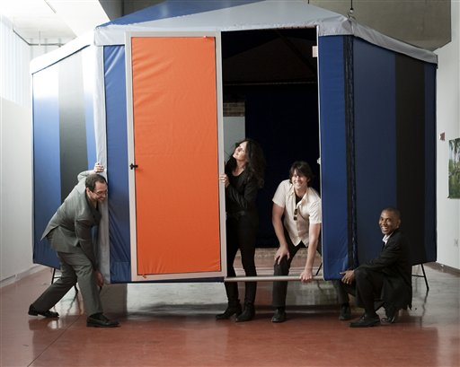
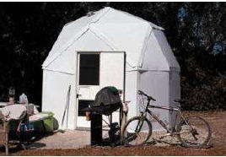
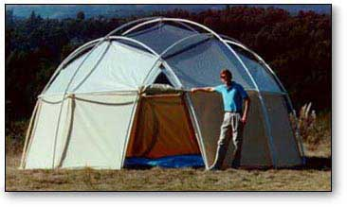
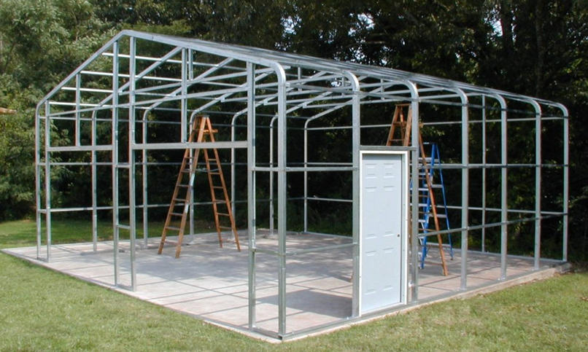
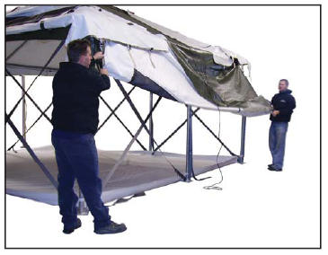
Examples of Commercial Transitional Shelters
SOFTHOUSE weighs 400 lbs; sells for $3K; 166 sq ft; takes 1 day to build.
Trans Shelter U Dome 110
Celina Tent HGPT

Slide 11
Transitional Shelter Characteristics
Constructed from steel tubing / aluminum / plastic.
  Small rigid or fabric wall shelter = 160 sq ft; 8-12 ft high; price /unit $3K and up.
    Ex: World Shelters, Shelters of America, Villagedome,
Provide a substantial protective shell.
Usually much larger than emergency shelter.
Require manual or power tools to set up and tear down.
Can take a day or weeks to build.
Can require heavy machinery (i.e., forklifts) to emplace.
Contain loose parts (bolts, panels, tubes, windows, fasteners).
Require 2-4 trained personnel to assemble.
Can use complex instruction manuals.
Some of these characteristics are hidden costs and burdens (about 15%-20%) added to unit price and usability.

Slide 12
What if….
We develop a shelter:
  That is a ‘gap-filler’ dwelling used logistically between emergency and transitional shelter…
  Uses no moving parts, no glass, no fasteners, no rivets, no instructions, no skilled labor, no heavy machinery….
  That incorporates basic living necessities like water storage, personal storage, 360 degree ventilation, lighting, electricity, ability to grow food, contain human waste ….
  That integrates reusable energy technology, commercial available materials and processes into the design… cheaply…
  That considers UN Shelter Centre guidelines concerning sustainability, cultural, usability, environmental safety and health factors…
  And takes a systems engineering approach to design.

Slide 13
Standard Systems Engineering Approach
International Council of Systems Engineering (INCOSE) definition:
“Systems Engineering is an interdisciplinary approach and means to enable the realization of successful systems. It focuses on defining customer needs and required functionality early in the development cycle, documenting requirements, then proceeding with design synthesis and system validation while considering the complete problem:
  Operations
  Performance
  Test
  Manufacturing
  Cost and Schedule
  Training and Support
  Disposal
Systems Engineering integrates all the disciplines and specialty groups into a team effort forming a structured development process that proceeds from concept to production to operation. Systems Engineering considers both the business and the technical needs of all customers with the goal of providing a quality product that meets the user needs.”

Slide 14
Tailored Systems Engineering Approach
Develop a tailored set of system and detail requirements that covers: cost, weight, performance, materials and processes, customer, user, health and safety, manufacturing, logistics, and human factors.
Identify and mitigate risks and perform tradeoff studies early.
Follow a tailored design review process to ensure system satisfies requirements.
  System and critical design reviews only.
Uses a simplified development qualification test program.
Incorporate lessons learned and UN Shelter Projects guidelines into the system.
  Involve UN and Red Cross representative (user community) early.
Design with a target unit production cost of $3,000.

Slide 15
Systems Engineering Requirements - Examples
Need Statement | System Engineering Requirement | Verification
Unit is setup/torn down in a small area. | Can be setup or disassembled in a 15-20 ft sq area. | Demo
Accommodates family of 4 (adults and children). | Provides min of 100 sq ft of floor space; provides 50 sq ft for standing by 95%tile adult. | Demo
Requires no heavy manual lifting. | No lift exceeds 80 lbs floor to waist by adult 50%tile. | Test
Easy to assemble. | Can be assembled without tools by 2 50%tile adults. | Test
Provides protection from environmental elements. | Can withstand 50 mph wind/4 hrs; 10 lb/sq ft snow load; 1 inch rain/hour/8hrs; | Analysis
Has mechanical interface for lifting. | Stackable container / has forklift slots. | Inspection
Withstands transportation loads. | Packaged to withstand 50 g lateral impact w/ no breakage. | Analysis
Easily transported to distribution point. | Transported in ISO containers . | Analysis
Easy to ship. | Requires no throwaway packaging materials. | Inspection
Is setup in reasonable time. | Setup in 30 minutes or less at the end user site. | Test
Provides storage for water and items. | Provides internal storage for water and personal items. | Demo
Provides visual privacy. | 1 minute of arc visible inside at 10 feet. | Analysis
Provides reasonable ventilation. | Provides 5 cfm at 12 noon to 8pm with 1 mph breeze. | Analysis
Incorporates reusable technology. | Provides interface for solar panel and LED lighting. | Inspection
Can be setup on level ground. | Floor/panels remain interlocked with 5 deg tilt in 2 planes. | Demo

Slide 16
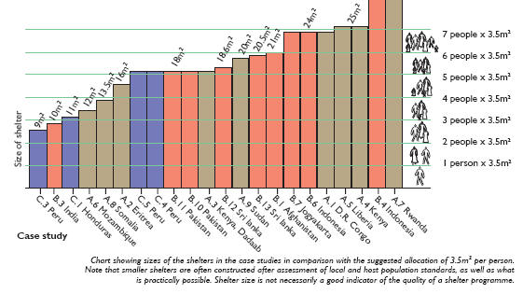
Incorporates lessons learned - Examples
Target floor space considers range of values for 3-4 people.
Design provides for interconnecting HOMEs to achieve goal of 3.5 m².
Data from UN Habitat Shelter Projects 2008.
Design Goal
“Note that smaller shelters are often constructed after assessment of local and host population standards, as well as what is practically possible. Shelter size is not necessarily a good indicator of the quality of a shelter program.”

Slide 17
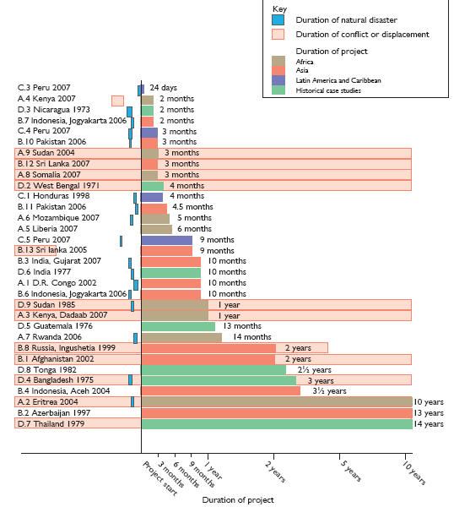
Incorporates lessons learned - Examples
Use life of shelter design, materials, and construction considers nominal length of displacement or conflict.
Data from UN Habitat Shelter Projects 2008.
Design Goal

Slide 18
HOME Subsystems
HOME System
Electronics
External Environment
Internal Environment
Agricultural
Structural
Solar panels
Rain
Ventilation
Plant type
M & P
Wiring
Solar
Heating
Lifecycle
Outer door
Batteries
Wind
Cooling
Soil
Inner screen
LED Lighting
Soil
Humidity
Insects
Stress
Inverter
Humidity
Moisture
Fertilizer
Loads
Connectors
Temperature
Noise
Drainage
Floor panels
Controller
Seismic
Lighting
Solar exposure
Wall panels
Outlet
Irrigation
Power cap
Use life
Furniture
Heating
Human Waste Containment
Column
Water Collection
GrowBowls
Tank
Shelves
Baffle bags
Collars
Hose
Table
Toilet seat
Ring seals
Faucet
Interface
Lever
Captive screws
Indicator
Stress
Paddles
Connections
Loads
Frame
Sediment filter
Mechanism
Micro organism filter
Limit stops

Slide 19
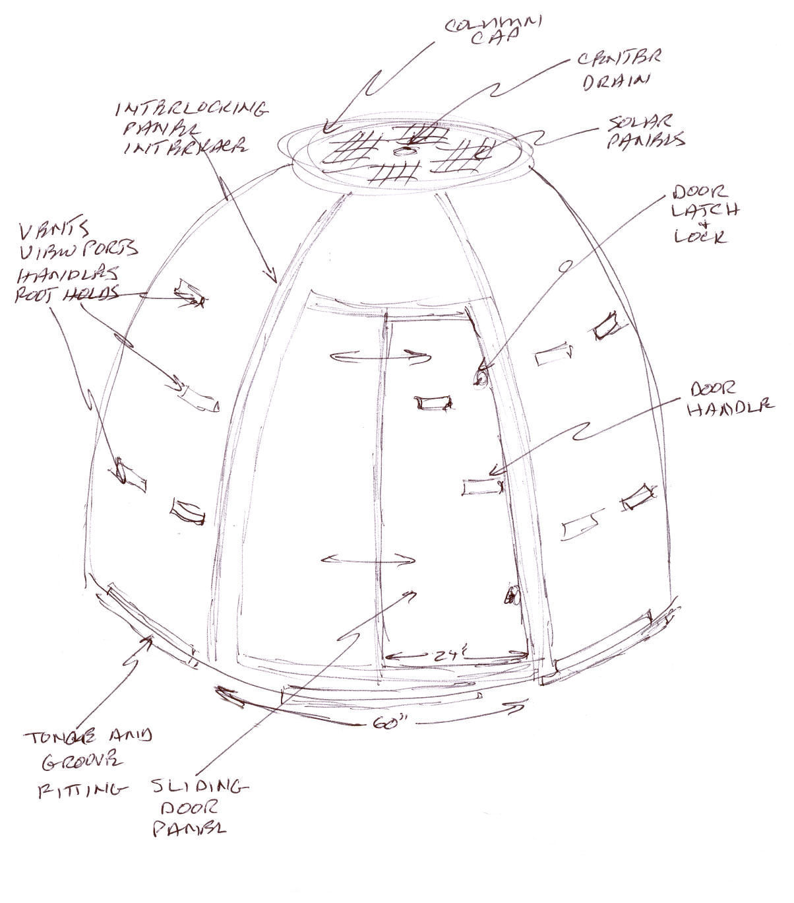
Notional Design – Isometric View
12 ft dia = 110 sq ft usable floor space.
7’ high at center; 6’ high 4’ from center
6 arched panels interlocked to 6 floor panels and a center column.
1” thick soybean plastic and foam polymer wall panels regulate temp.
Chamfered slots in wall panels are handholds, footholds, view, light and vent ports, & interface for GrowBowls.
Power cap contains solar photo voltaic panels & electronics.
Power cap funnels water to internal storage tank in column.
Column stores water and supports shelves and table.
Total shelter consists of 30 parts with a total estimated weight of 225 lbs.

Slide 20
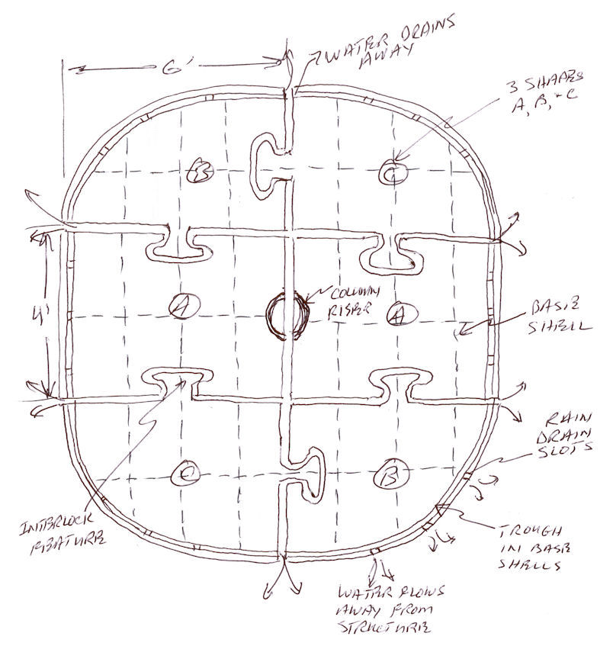
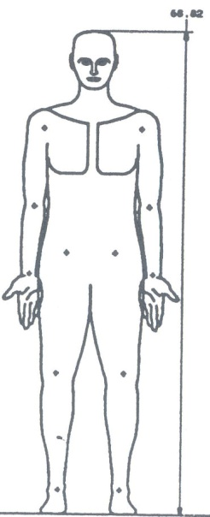

Notional Design Details – Base Panels
6 molded interlocking floor panel shells made from soybean plastic.
  Stiffeners provide rigidity.
3 unique base panels; 2 center and 2 pairs of corner panels.
  Structure more likely oblong rather than circular.
3 inch deep flexible molded floor panels tolerate uneven dirt surface (1 – 5 deg).
Perimeter pair of risers hold each wall panel.
Outer riser lower than inner riser allows rain water to flow away from structure.
  Outer riser interrupted with bleed grooves.
Provides external tie down interface.
Each panel weighs about 15 - 20 lbs.
95th %
5th %

Slide 21
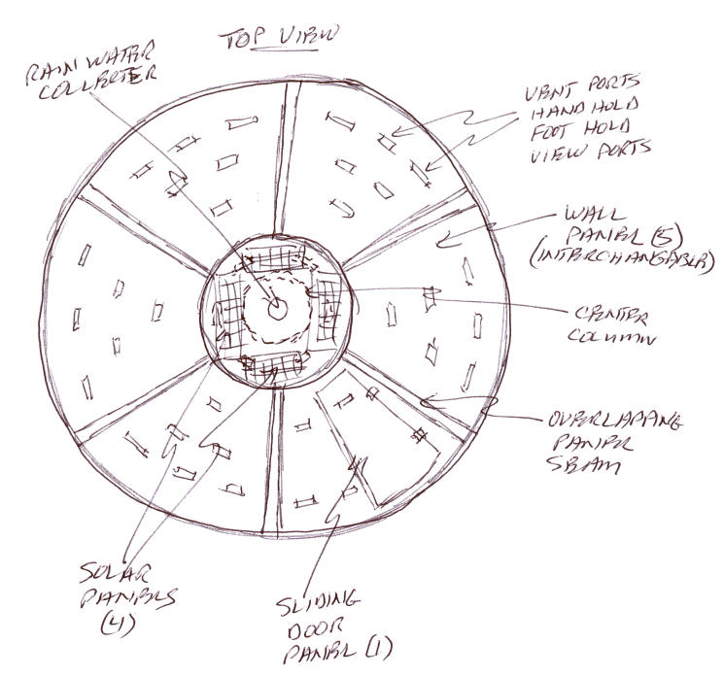
Notional Design Details – Top View
Wall panels overlap with an expansion joint designed to keep out rain. No fasteners required.
  However, each wall panel may be interlocked to adjacent panel with a 1/2 inch dia PVC stringer.
Loose interfaces between wall and floor panels, and column mean less tolerance control needed.
Each wall panel has 5-6 inches of contact at top of the column.
1 unique wall panel with sliding hatch; 5 other interchangeable panels.
Entire structure is a compression fitting - like a wine barrel.

Slide 22
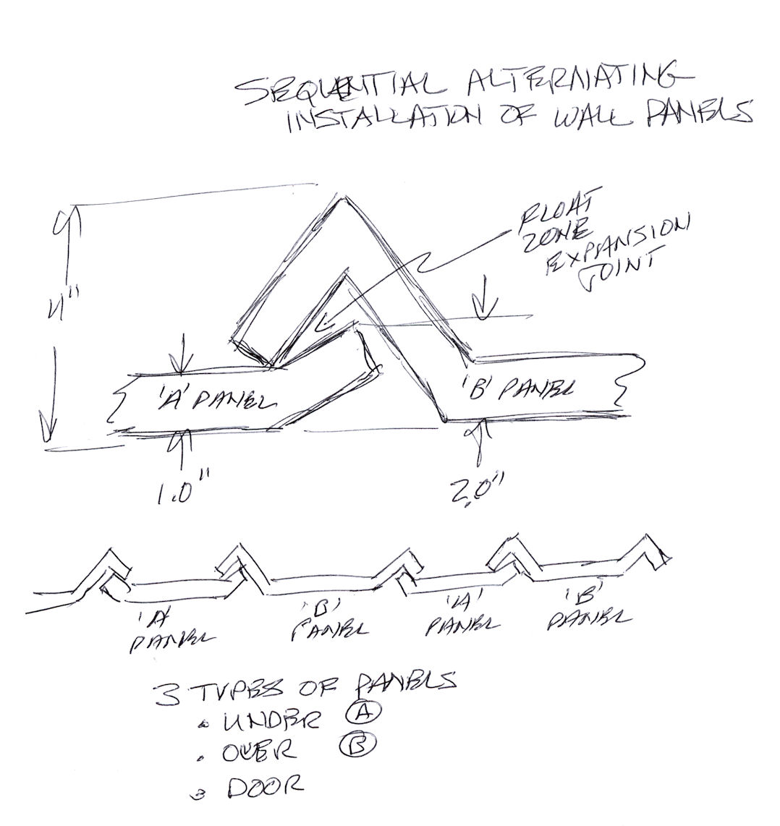
Notional Design Details – Panel Interfaces
Wall panels designed to overlap with expansion joint.
Two types of wall panels; under (A) and over (B).
Requires sequential, alternating installation of wall panels.
Rain runoff, wind, insects, etc. prevented from entering shelter.

Slide 23
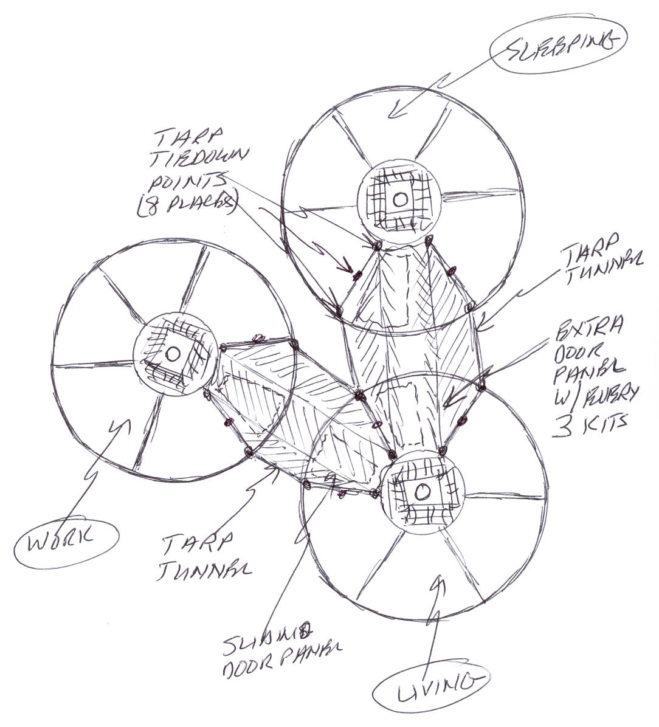
Notional Design Details – Modular Living
Every 3rd kit includes extra wall panel with door and 2 tarps.
  Additional cost about $30.
Enables interconnecting HOMEs with tarp tunnels.
  Lightweight, easy to install.
Door panel includes mechanical interfaces (hooks) on every wall panel to attach tarp.

Slide 24
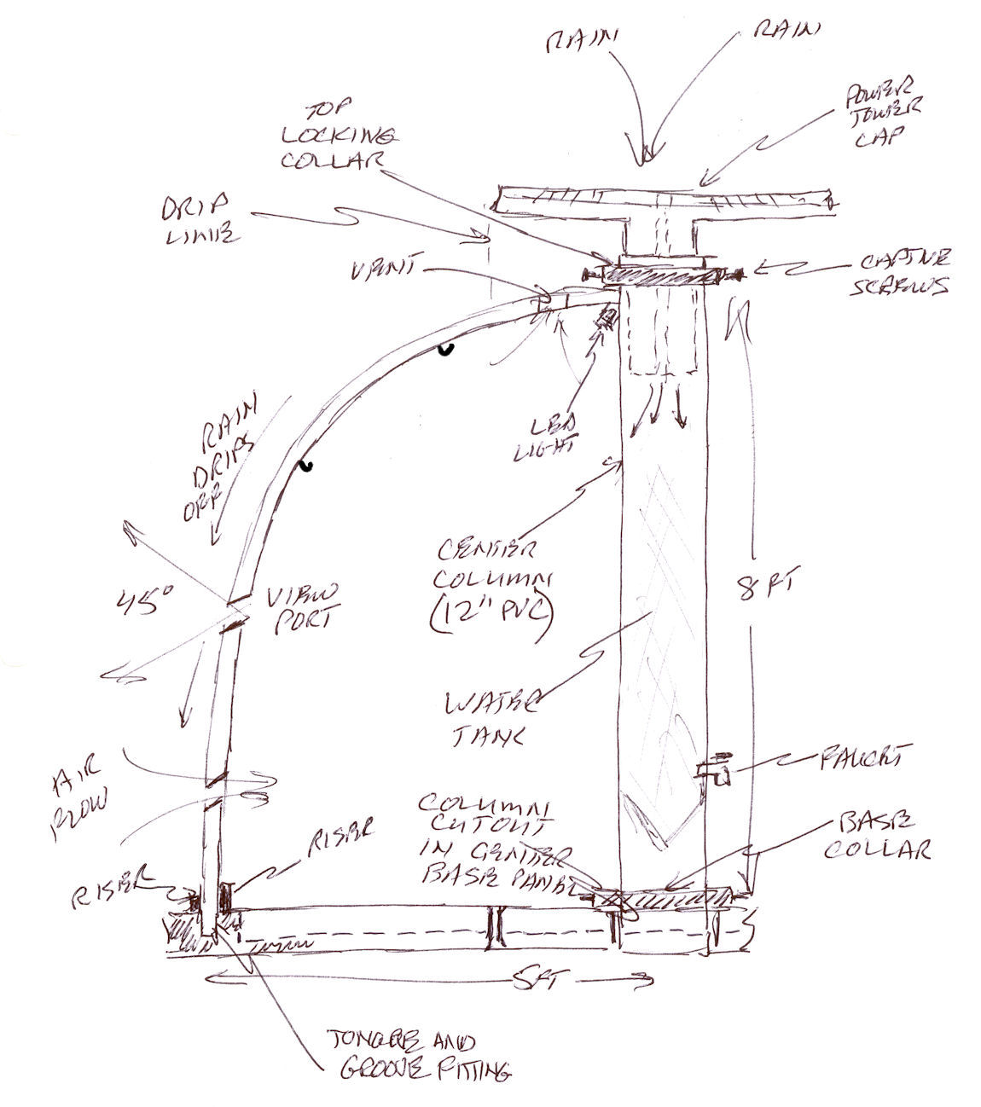
Notional Design Details – Side View, Internal
Center column self aligns to semi-circular risers in 2 center floor panels.
  Numbers show 5 assembly steps.
Column secured to floor shells with 2-piece locking collar.
8’ column provides 7’ standing room near center.
Wall panels self align into floor panel circular troughs (360 deg).
  Handling wall panels similar to 4’x8’ sheet of plywood.
Redundant large, gross thread, captive thumbscrews in collars secure wall and floor panels to column, top and bottom.
Column power cap funnels rainwater to storage tank with no overflow.
5
4
3
2
1
5

Slide 25
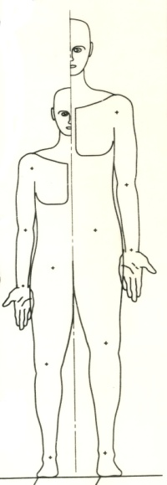
Notional Design Details – Side View, Internal
Internal 36” - 60” x 10” diameter water storage tank holds 70 – 117 gals water. Like a rain barrel.
Weight of water adds 350 - 550 lbs.
Rain water overflows up and out thru center of cap.
Removable primary screen at inlet filters large sediment.
Secondary mesh at bottom of cap filters microorganisms.
10’ hose with bib attaches to pass through valve at column base.
7
6
95%
5%
5
4
3
2
1

Slide 26
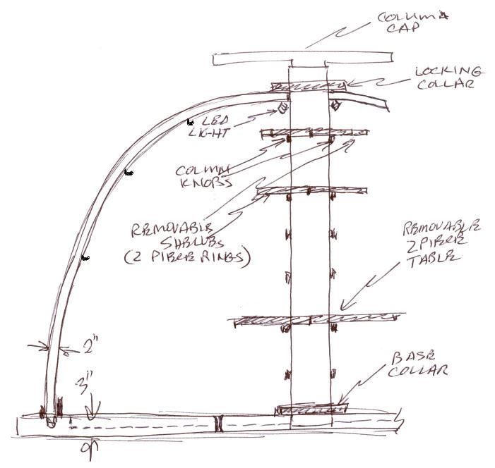
Notional Design Details – Storage, Internal
6 column ‘rings’ support semi-circular 6” and 12” wide collars for 180 or 360 degree storage shelves and table.
Standoffs enable adjustable height and clearance.
No fasteners required; shelves slip lock into place.
Molded hooks on wall enable users to hang pictures, clothes, string or cords, sheets, etc.

Slide 27
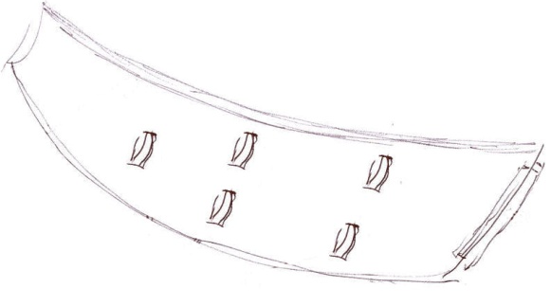
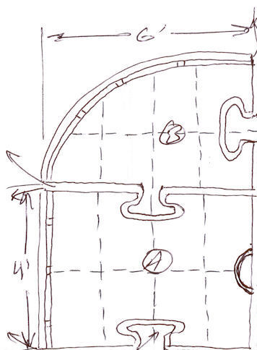

Notional Design Details – Reuse, Recycle
When transitional housing is available –
Wall panels used as raised platform for beds or benches.
Floor panels used as tables.
Column used for irrigation pipes connected by collars.
Entire structure reused for rodent & insect-free storage or play structure.
Horizontal wall panel
2 panels together make a 6’ X 8’ platform for sleeping
Column becomes a section of irrigation pipe.

Slide 28
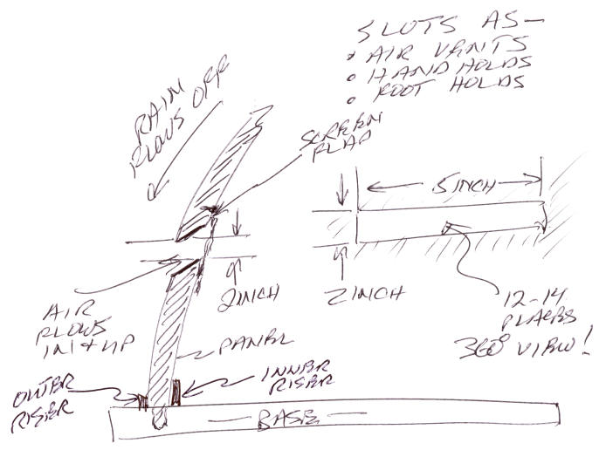
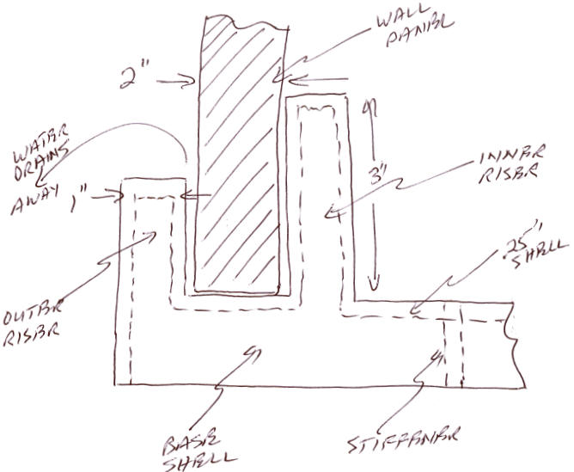
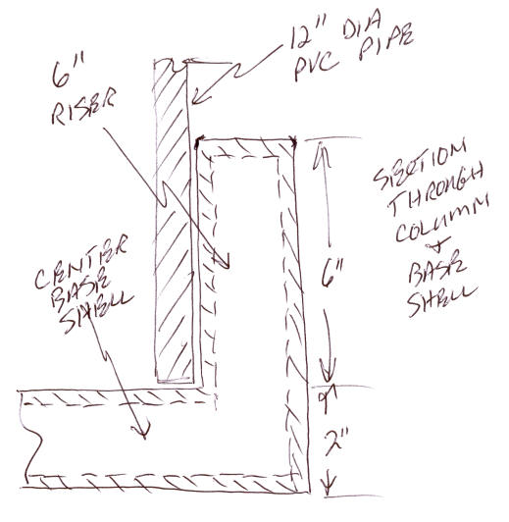
Notional Design Details - Interfaces
Staggered angled 3”x 6” ports enable 360 deg viewing.
Chamfer prevents water from entering; 30 ports offer 540 sq. in. with 360 deg ventilation.
Rodent / insect screen on panel slot offers safety and privacy.
Higher inner riser prevents runoff water from entering interior.
Riser in floor panels holds column in place during assembly; provides rigidity to structure.

Slide 29
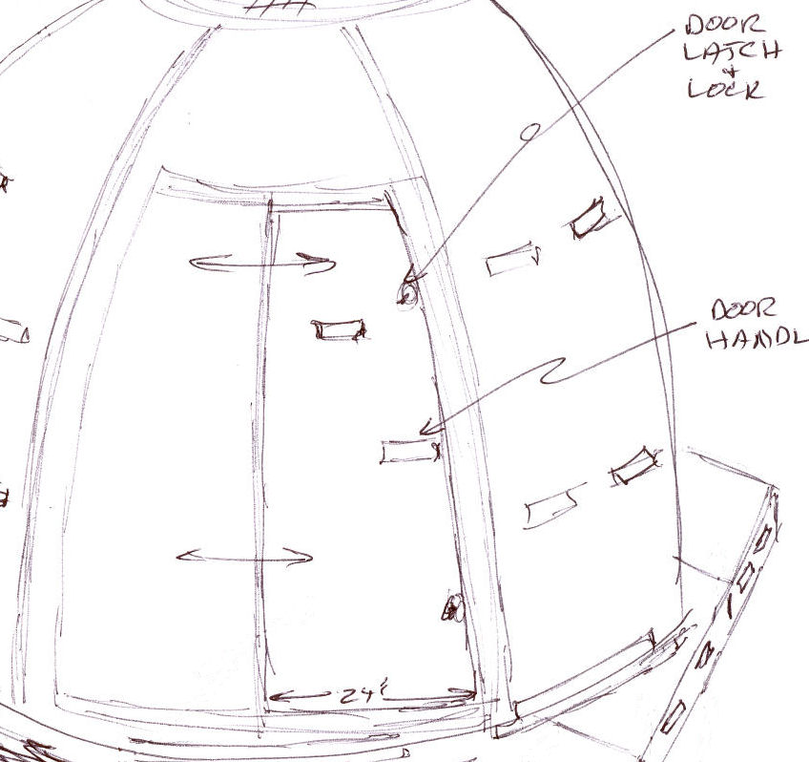
Notional Design Details – Entrance / Exit
Entrance/exit sealed with sliding, self draining panel.
  No hinges, pins or moving parts that break or fatigue.
Primary entrance secured with simple lever or latch.
  Will not bind or hang up with debris buildup.
  Will not leak or provide vector for insects.
Secondary feature is rigid, insect-proof screen for ventilation.
  Option: may be integrated with primary entrance.

Slide 30
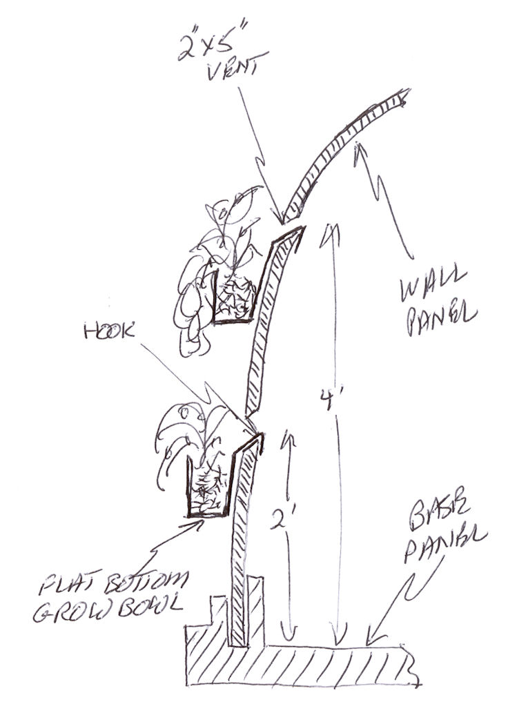
Notional Design Details – Green Living Shelter
Each kit includes 10 molded, plastic, 5”x5”x10” bowls called GrowBowls.
Removable bowl slips into vents.
Portability and interchangeability enables crop rotation to optimize sun exposure.
Flat bottom bowl will not flip over when set on level surface.
Good for growing bush beans, lettuce, peppers, cucumbers, onions, insect-repelling flowers, herbs.
Option: for initial delivery, inside surface infused with seeds and fertilizer indigenous to disaster region.
Alternative uses: food prep, carrying water, washing clothes, sponge baths, etc.
  This system enables barter, trading and community activity among thousands of people living in camps…

Slide 31
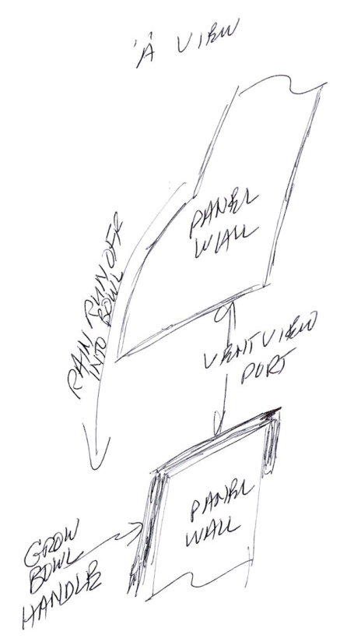
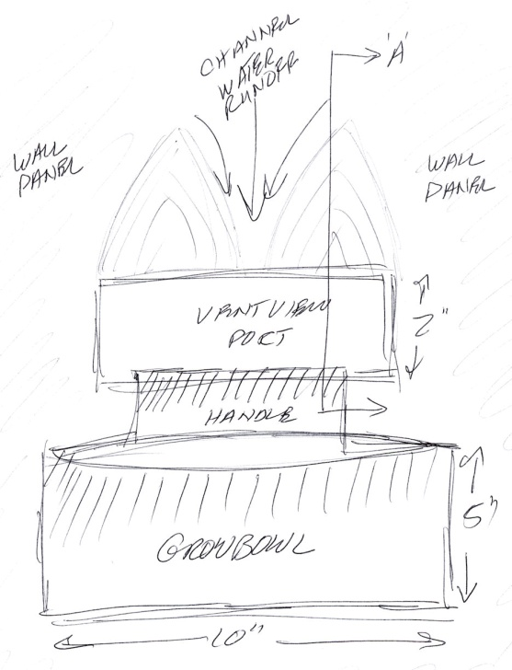
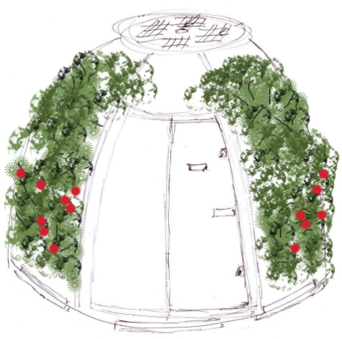
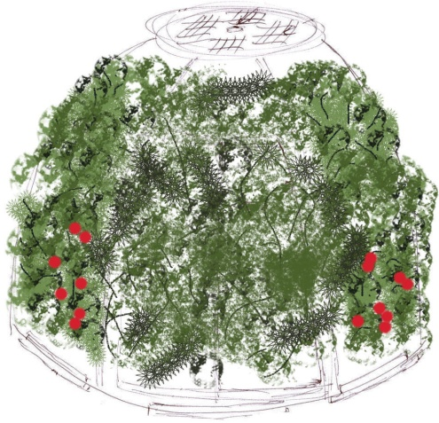
Notional Design Details – GrowBowls
Molded wall panels designed to channel sun, rain, and wind.
Wall panels contoured above vent ports to channel water to the center of the GrowBowl.
Contours prevent runoff from dripping inside shelter.
Living green shelter shades exterior, cools interior.

Slide 32
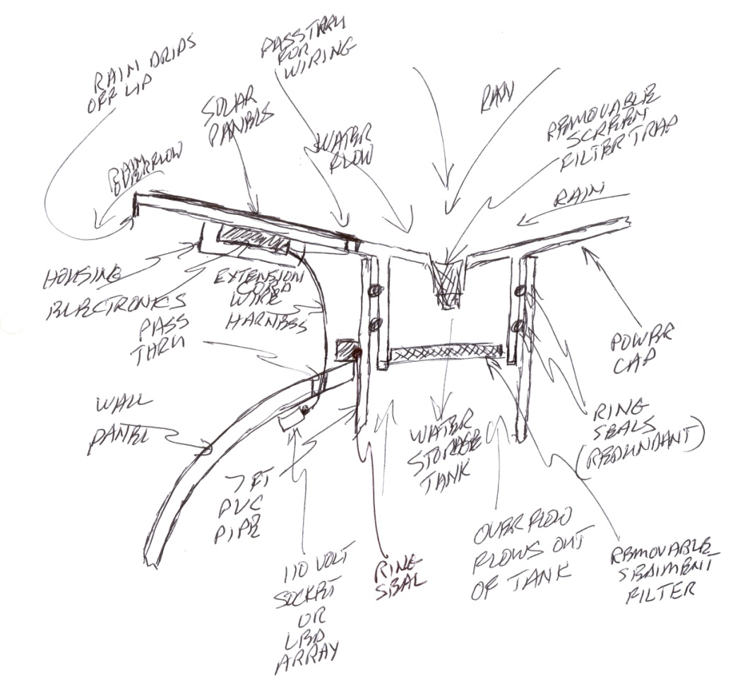
Notional Design Details – Power Cap
Power cap funnels water to inlet in center of cap.
Removable screens filter debris, sediment and micro-organisms.
Redundant ring seals in power cap prevent overflow; water flows out beyond wall panel vents.
2-piece column locking collar uses redundant ring seals to prevent water from entering interior.
Electronics mounted to underside of power cap.
Lip on edge of cap allows water to drip down away from electronics.
Electronics protected yet accessible inside enclosure.
Wire harness (10’ commercial extension cord) pass through cable threaded into interior of shelter.
Connects to LED light array, 110 volt socket and adapter.

Slide 33
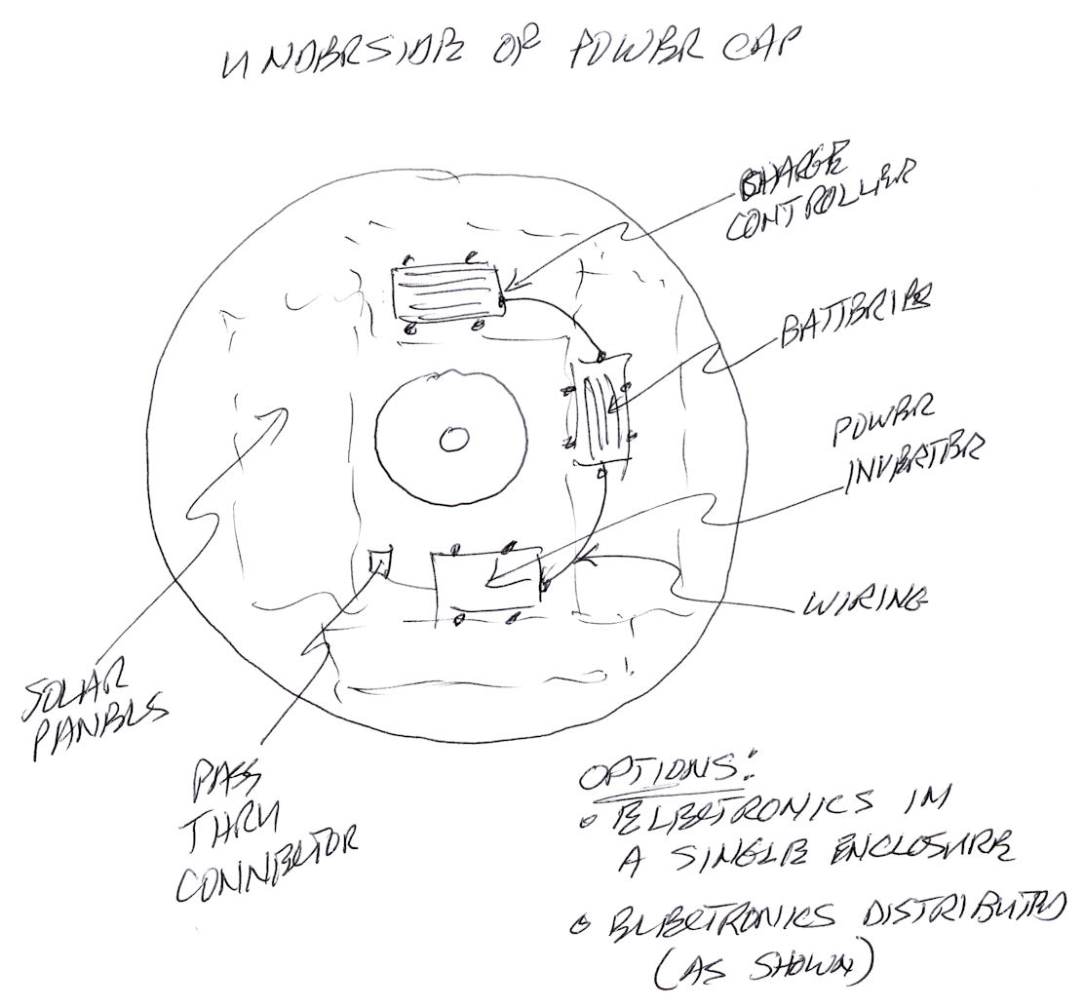
Notional Design Details – Electronics
Electronics mounted to underside of power cap.
Two options:
  Distributed
  Consolidated
Removable enclosure provides environmental protection.
  Maintains accessibility.
Downside: wiring exposed for pass through cable and connector.

Slide 34
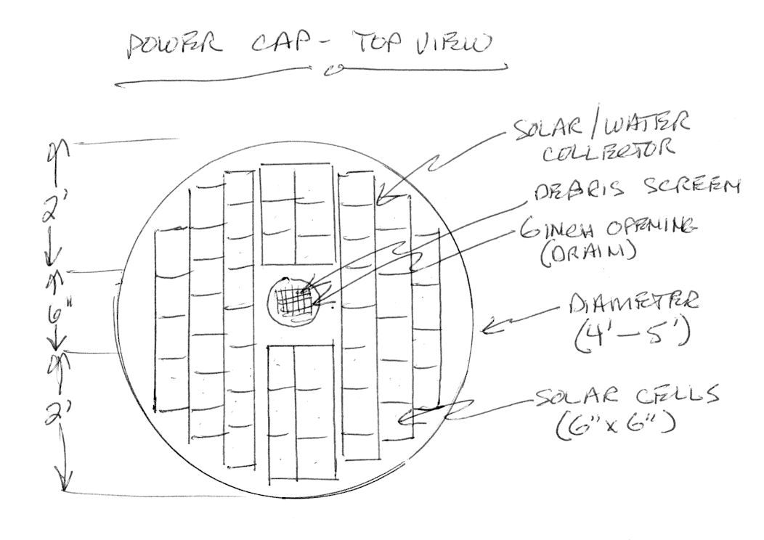
Notional Design Details – Power Cap
4’ – 4.5’ diameter power cap could hold 40-50 6x6 solar cells.
Tradeoffs:
  What is optimal size of collector….
    For solar power?
    For manufacturing?
    For aesthetics?
    For shipping / handling?

Slide 35
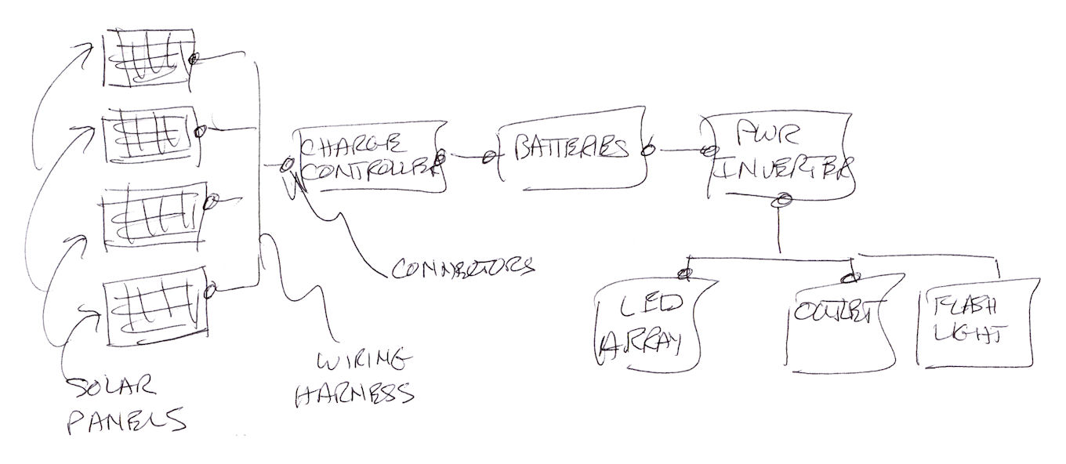
Notional Design Details - Electronics
COTS parts minimize cost: solar panels, batteries, wiring, connectors, LED arrays, flashlight.
NDI: charge controller, power inverter.

Slide 36
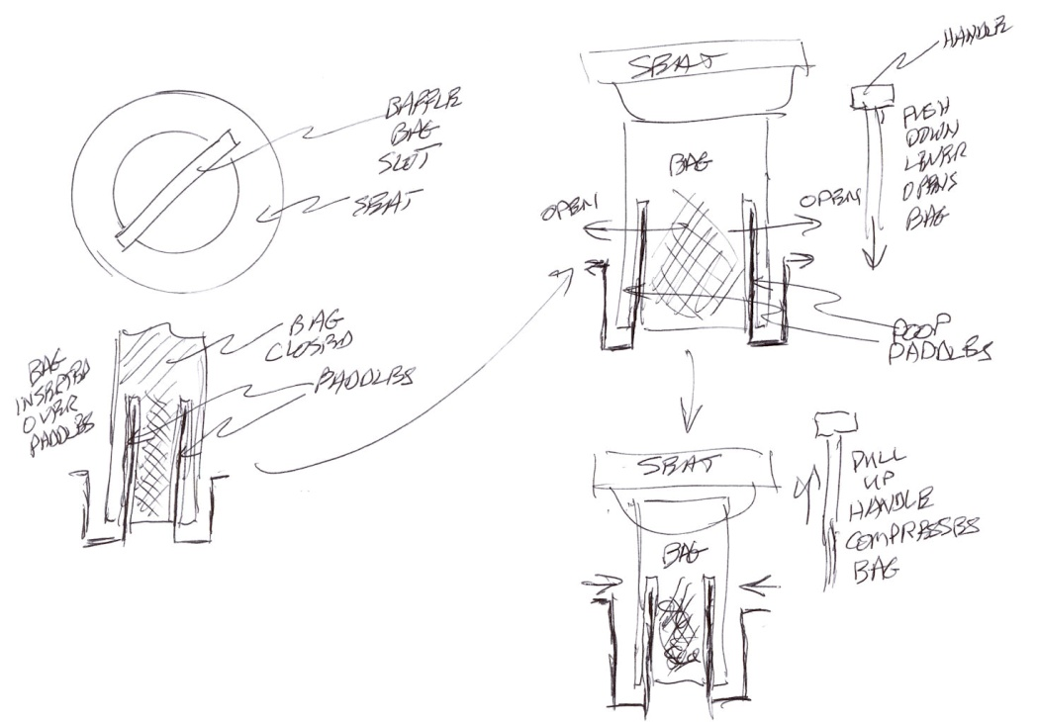
Notional Design Details –
Temporary Human Waste Containment
System consists of a frame with seat and baffled containment bags.
Uses solid plastic frame, seat, mechanism, lever, and paddles.
Baffle bag inserted through slot in seat and over dual paddles.
User pushes lever down to open bag; pulls lever up to close bag in a controlled squeeze.
Paddles squash poop and piddle (PnP) to 0.5 inch thick mass.
Limit stops prevent damaging bag when opening or over squeezing contents after activity.
Waste absorbed by bio degradable absorbent bag infused with enzymes and bacteria.
Contents compostable so no one left holding the bag…

Slide 37
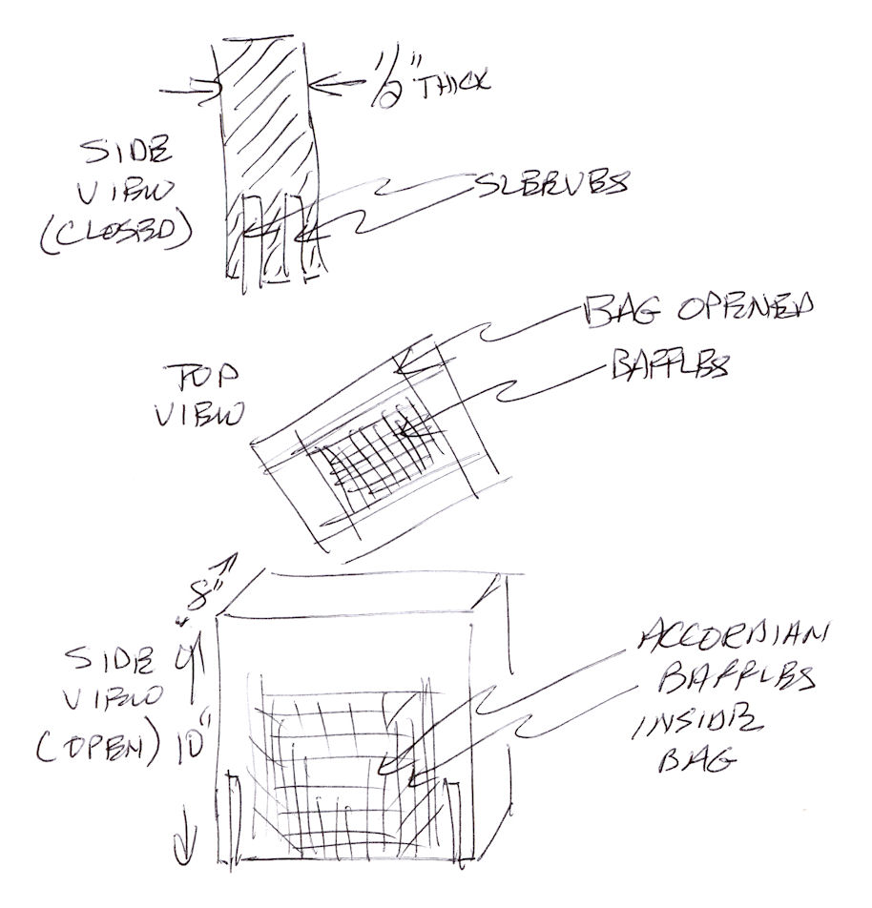
Notional Design Details – Baffle Bag Design
Baffle bag is grocery bag size (16” H x 12” W x 8” D).
Each wide side has a built-in sleeve or pocket.
Dual paddles in toilet frame fit into sleeves.
Staggered, differentially spaced accordion baffles distribute PnP evenly during controlled squeeze.
Bag is inexpensive, wood pulp, absorbent diaper.
Production cost goal: 20 cents @.
  Sustaining market product.
Notes:
This system is cheaper than RESTOP or other solid waste collection products used by outdoor wilderness enthusiasts for ‘packing out’ human waste. This device is meant to collect it immediately, disperse it, break it down, and contain it for timely burial or disposal. It’s a different principle than merely collecting it in a ‘poop bag’ for days. The RESTOP product collects it in a bag within a bag for carrying around on your back. This system is not intended for transportation of poop but the immediate dispersal and breakdown of it.

Slide 38
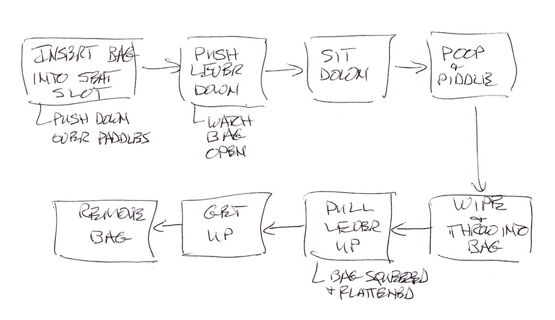
Notional Design Details – Baffle Bag Flow
Human waste captured in recycled wood fiber, baffled, biodegradable bag for temporary containment until buried.
Not a RESTOP-type product (retail $3 @) for indefinite containment.

Slide 39
Systems Engineering -
Sample Risks and Mitigations
RISK
Lack of Funding
Material Aging / Low Shelf and Use Life
Material Failure
High unit cost
Lack of User Acceptance
Material Misuse
MITIGATION
Business Plans.
Materials & Processes Plan.
CAD Stress analysis.
Manufacturing Plan.
Materials & Processes Plan.
Usability research.
Health / Safety Plan.

Slide 40
Some unanswered questions.
Is it possible to manufacture plastic panels that are stiff enough to remain interlocked after 5 years of environmental stress?
Will wall panels withstand 60 mph horizontal sheer wind without blowing apart?
What is the cost and weight difference between a 12’ and a 10’ diameter structure?
What kind of heating is feasible, (i.e., no flame, no external fuel source) to keep the interior above 50 degrees F with 2 adults inside?
How do you secure the structure to the ground cheaply, easily, and without tools during emplacement?
How much air circulation do you really have with 30-40 3”x6” champher openings?
How do you prevent rupturing the water column when it freezes?
Will a 99th percentile male sitting on top of the power cap break it?

Slide 41
Next Steps – Plan A
Collaborate with URI College of Business Administration (CBA) to develop business plans, risks and opportunities.
  As of 1 October 2010, unknown involvement.
Collaborate with URI College of Engineering (COE) to develop CAD model, stress analysis, structures, engineering plans, and build prototype.
  As of 1 October 2010, the project is one of the COEs Capstone Projects.
Collaborate with URI College of Environment and Life Sciences (CELS) to develop agricultural models, sustainable energy system, & human waste containment.
  As of 1 October 2010, on hold.
Goal: Win a $200K Rhode Island Economic Development Council STAC (Science and Technology Advisory Council) grant for URI.

Slide 42
Conclusion
This could be a great URI COE, CELS and CBA academic collaboration project to investigate a viable solution for an endemic, recurring world problem.
Or it could be a real ‘gap-filler’ shelter designed, developed, and manufactured in Rhode Island for millions of people in the United States and around the World…
“I want the University of Rhode Island to be an institution that’s engaged very broadly on a global basis, especially in Africa and Asia”.
David Dooley, URI president.
Inauguration Speech, April 4, 2010.

Slide 43
Appendix
Sources and references
Target production cost
Strategic partners and suppliers
Prototype Development staffing and skills
Development Phase Products
Team concept of operations
Potential customers
Field of dreams
Rev 26; September 13, 2010

Slide 44
Sources and References
shelter centre, ‘Transitional Shelter Guidelines’, May 2009.
World Shelters, ‘TransShel Proposal for Haiti Relief’, Transitional Shelter – Localizations to Recovery, 2009.
Transitional Shelter Prototypes, shelter centre, November 2009.
Shelter Projects 2008, UN Habitat, UNHCR, 2008.
shelter centre, Supporting the community of practice of the humanitarian shelter sector, CWGER Plenary Meeting, 22nd September 2008.

Slide 45
Target Production Costs
Base panels (6) = $250
  Single sided molded plastic panels with underside stiffeners.
Wall panels (6) = $600
  Double sided molded soybean plastic; heat absorbing-dissipating foam filled panels; thin skin; approximately 1 inch thick; one unique panel with sliding panel for door.
Power Cap = $1200
  Soybean plastic injection molded cap, solar cell assemblies (4), wiring harnesses, rechargeable battery pack, LED light arrays, connectors, charge controller, power inverter, electronic enclosure, water filters, assembly labor.
Column = $200
  PVC pipe (8’ = $120), hose assembly, connections, assembly labor.
Miscellaneous = $350
  10 GrowBowls, 4 locking collars with tapped threads and seals, 8 threaded hand screws, 4 shelf and 2 table segments, 2 tarps, ‘baffle bag’ toilet.
Packaging = $3o0
  Strapping, assembly labor.
Production cost goal = <$3,000.
Wholesale price goal = $4,000.

Slide 46
Strategic Partners and Suppliers in RI and VA.
Hasbro, Inc., 1011 Newport Avenue Pawtucket, RI, 02861. 401-431-8697.
  International company with molded plastic experience.
American Power Conversion, 132 Fairgrounds Road,
West Kingston, RI, 02892. 401-789-5735.
  Electrical engineering company to provide production wiring and power circuit fabrication.
Alteris Renewables, Inc., 20 Burnside St 2nd Floor Bristol, RI, 401-396-9999.
  Solar panel systems experience and renewable energy.
Mars Plastics, 45 Troy Street & 40 Agnes Street, Providence, RI, 02909. 401-421-5275.
  100,000 sq ft injection composite molding facility.
Tri-Mack™ Plastics Manufacturing Corp., Bristol, RI. 401-253-2140.
Newell Rubbermaid Commercial Products, 3124 Valley Avenue Winchester, VA 22601. 540-667-8700

Slide 47
Prototype Development Staffing & Skills
Executive Council
Dean’s Reps
(CBA, COE, CELS),
EDC, R. Davids
Total EP = 16
EP
EP
EP
0.5
COE Lead
0.5
CELS Lead
0.5
CBA Lead
1.0
Materials & Processes
1.0
Solar Energy
1.0
User Analysis
1.0
Solid Modeling / CAD
1.0
Plant Science
1.0
Marketing
1.0
Electronics
0.5
Chemistry
2.0
Plans
0.5
Structures
1.0
Bioengineering
0.5
System Security
0.5
System Engineering
0.5
System Safety
0.5
Contracts
0.5
Proposal Coordinator /
Spec Writer
0.5
Proposal Coordinator /
Spec Writer
0.5
Proposal Coordinator

Slide 48
Development Phases
Phase 1
  Requirement Development and Review
Phase 2
  Conceptual Design and Review
Phase 3
  Critical Design Review
Phase 4
  Prototype Design

Slide 49
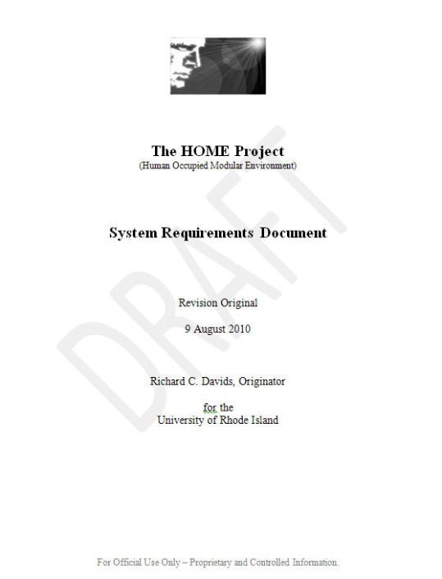
Development Phase 1
Requirement Development and Review
  Preliminary set of system and subsystem requirements for the electronic and mechanical subsystems, including:
    Environments (Seismic, rain, solar, wind)
    Electronic parts (Solar cells, inverter, LEDs, wiring)
    Materials and Processes (Plastics, foam, polymers, rubber)
    Loads and stress (Point, shear, compression, expansion)
    Health and Safety (Biohazards, human factors)
  Personnel: 2-3 EP (1 EP = 8 hrs. / wk)
    Most likely 1 system engineer and PT mechanical and electronical engineers.
  Time wise: Kickoff plus 3 months.

Slide 50
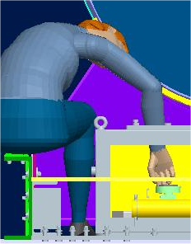
Development Phase 2
Preliminary Conceptual Design
  CAD Solid model
    High fidelity computer model showing interfaces, electronics, solar panels, interior features, human computer models, etc.
  Preliminary stress and loads analysis.
  Drawing tree flushed out.
  Spec sheets for critical items (electronics, materials).
  All critical interfaces identified and analyzed.
  Personnel: 2-3 EP
  Time wise: Kickoff plus 6 months.
Example of CAD human computer model.

Slide 51


Development Phase 3
Critical Design Review
  90% drawings started or completed
  Desktop scaled model of shelter completed
    Stereolithographic preferred.
    FOAMCOR, plastic, wood optional.
    Used to demonstrate assembly, design features, logistics, etc., to customers.
  Personnel: 2-3 EP
  Time wise: Kickoff plus 9 months.
Examples of Soft Mockups

Slide 52
Development Phase 4
Prototype Design
  Full scale physical model
    Showing true dimensions
    Constructed of rubber, plastic, foam
  Shows all structural features (cutouts, seals, electronic boxes).
  Used for developmental qualification testing.
    Solar power capacity, logistics, usability.
  Personnel: 2-3 EP
  Time wise: Kickoff plus 12-16 months.

Slide 53
Team Concept of Operations
Weekly activity reports
  Short, 1 paragraph, NTE 50 words, each team member
    Due Friday morning
    Uploaded to closed web site by proposal coordinators by 12 Noon, Friday.
Weekly meetings (or telecons)
  Published agenda by 8AM day of meeting (Friday)
    Friday 1PM and 2PM meetings
  30 minutes – Team Leads
  30 minutes – Executive Council
Engineering Notebooks
  Hardcopy, daily entries, to include ideas, phone calls, sketches, diagrams, calculations, references, etc.

Slide 54
Potential Users
National Park Service
International Committee of the Red Cross
International Habitat for Humanity
Federal Emergency Management Agency
Red Crescent Movement
United Nations High Commission for Refugees

Slide 55


University of Rhode Island - Field of Dreams….
This?...
Or this?...

